Slide 1

ICEG
REVIEW COMITE
11/12/2024

Slide 2
Welcome & agenda of the meeting

Slide 3
AGENDA
TOPIC | SPEAKER | TIMING
Welcome and agenda |  | 14u00 – 14u05
Overview of changes to the cooperation agreement | Marc/Eveline | 14u05 – 14u15
Procedure for signing the cooperation agreement | Marc | 14u15 – 14u25
Up-to-date list of ICEG review comite composition | Workgroup | 14u25 – 14u35
News on topics on hold | Workgroup | 14u35 – 14u45
Brainstorm on new topics for ICEG | Workgroup | 14u45 - 14u55
Recap 2024 and planning 2025 | Eveline | 14u55 - 15u05
Other? Regional Data Code (see question Eric) Brainstorm on extra activities | Workgroup | 15u05 - 15u15

Slide 4
Overview of changes to the cooperation agreement

Slide 5
Procedure for signing the cooperation agreement

Slide 6
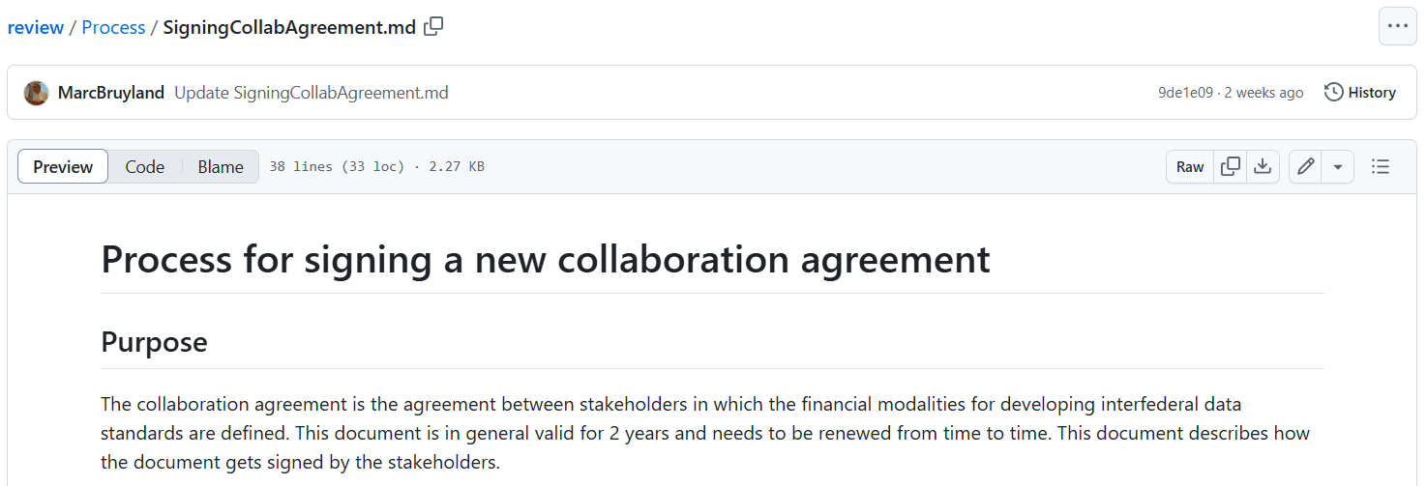
Signing Collaboration Agreement
Process steps
STEP 1: BOSA
PTA (Person to Act): Marc Bruyland
STEP 2: Vlaanderen
PTA: Eveline Vlassenroot
STEP 3: Brussels Gewest
PTA: Eric Auquière
STEP 4: Fédération Wallonie-Bruxelles
PTA: Alexandre Delalieu
STEP 5: Région wallonne
PTA: Dominique Buffet
STEP 6: Deutschsprachige Gemeinschaft
PTA: Dominique Buecken
https://github.com/belgif/review/blob/master/Process/SigningCollabAgreement.md

Slide 7
Topics for ICEG Management Comitee 18/12/2024

Slide 8
Topics for ICEG Management Meeting 18/12/2024
Status Data Standardization
Status collaboration agreement
Budget 2025-2026
...
Who will present these topics?

Slide 9
Up-to-date list of ICEG review comite composition

Slide 10
ICEG Review Comite composition
Vlaanderen:
raf.buyle@vlaanderen.be;
eveline.vlassenroot@vlaanderen.be;
liesbeth.vanderhaegen@vlaanderen.be;
andreas.nikolakopoulos@v-ict-or.be
BOSA :
liesbet.dhondt@bosa.fgov.be;
bart.hanssens@bosa.fgov.be;
marc.bruyland@bosa.fgov.be;
Brussels Gewest:
ahof@gob.brussels;
bfricheteau@paradigm.brussels;
thoogewys@paradigm.be;
eauquiere@paradigm.brussels
See list on GitHub: https://github.com/belgif/review/tree/master
Fédération Wallonie-Bruxelles:
alexandre.delalieu@cfwb.be​
Région wallonne:
dominique.buffet@spw.wallonie.be;
xavier.demarets@spw.wallonie.be​
Deutschsprachige Gemeinschaft:
dominique.buecken@dgov.be​
NGI:
rink.kruk@ngi.be

Slide 11
News on topics on hold

Slide 12
Topics on hold
Topic | Budget (€)
ICEG: Person Start new trajectory | 71.100
ICEG: Hydrants Extra budget for additional semantic issues that need to be addressed by the firefighters and the water companies | 18.170 (20 MD)
Translation of the OSLO standards | 150.000
Assessment BeST | TBD: 13.000 (10 MD)
Total | 252.270

Slide 13
Budget foreseen in collaboration agreement
Contributing Organisation | Approved budget 2024 (€) | Cost allocationKey (%)
BOSA FOD Beleid & Ondersteuning | 80.000 | 27,59
Digitaal Vlaanderen | 80.000 | 27,59
Service Public de Wallonie (SPW) | 50.000 | 17,24
Paradigm (for the Brussels Region) | 20.000 | 6,90
ETNIC (for the Fédération Wallonie-Bruxelles) | 50.000 | 17,24
German speaking community | 10.000 | 3,45
Total | 290.000 | 100,00

Slide 14
Brainstorm on new topics for ICEG

Slide 15
Recap question 8/11/2024:
Based on best practices OSLO tools & methods, can we prospect for Belgif, the possible investment on:
Automatisation of the backend process towards online publication? (prio)
Improving user experience on the UI?

Slide 16
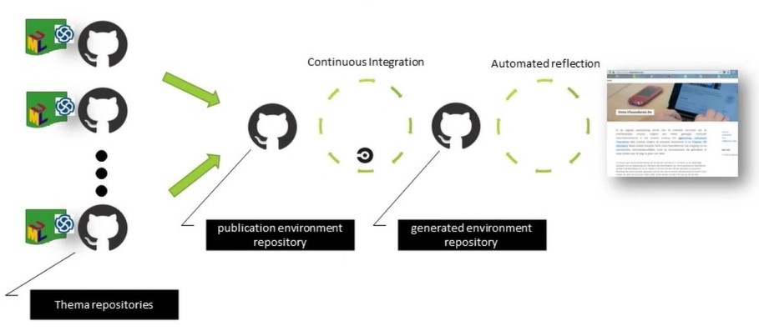
Publication process (data.vlaanderen.be)
Change request:
through “pull request”
→ Manual approval
Automatic push
towards frontend
Publication (UI)
GitHub = backend
→ Manual updates

Slide 17
Publication process (vocab.belgif.be)
Question:
In order to reduce
human/technical
bottlenecks: could we go
towards automatisation
of this step in the process?
Change request:
through “pull request”
→ Manual approval
Manual push
towards frontend
Publication (UI)
GitHub = backend
→ Manual updates

Slide 18
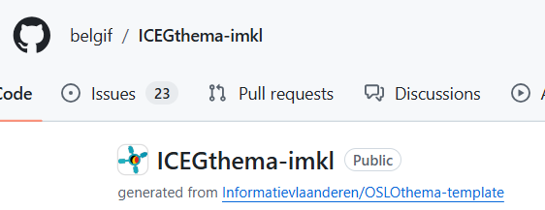
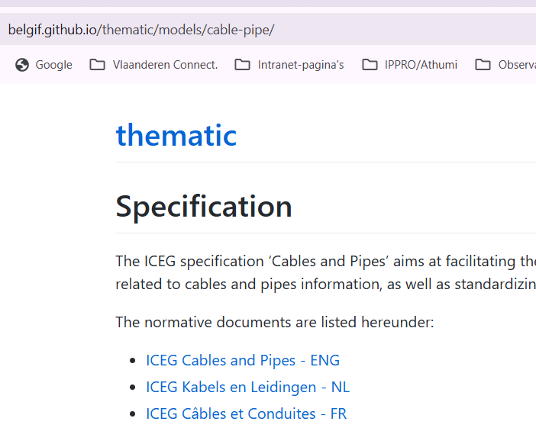
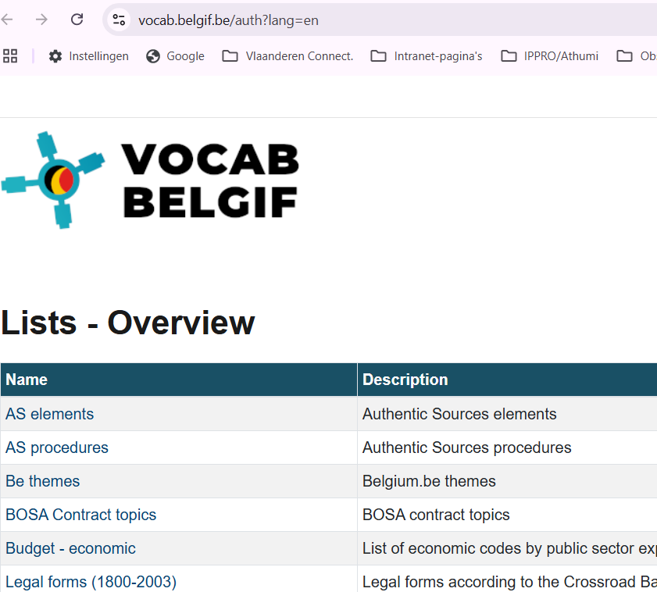
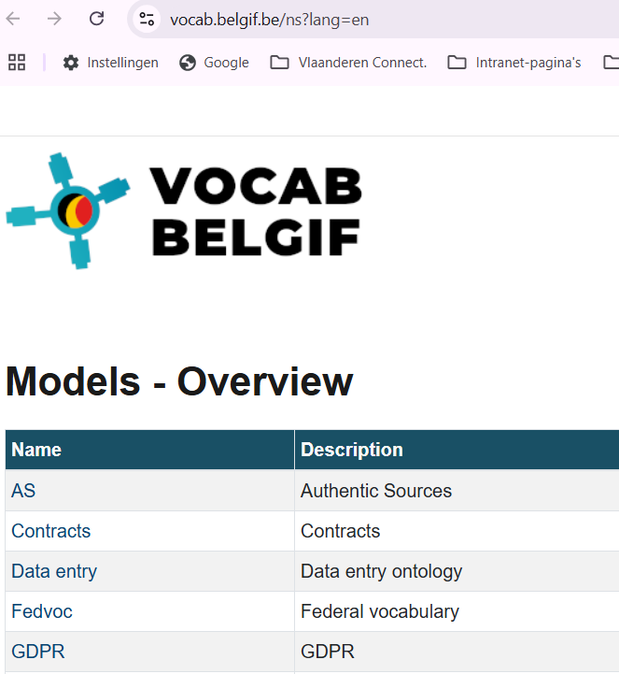
User experience (use case IMKL)
Backend (GitHub)
3 UI’s
Online Specification
(semantic model)
Codelists
(implementation model)
XSD-scheme
(implementation model)

Slide 19

ICEG Interoperability Training 2025?
No training organised in 2024
4/12/2020 - 82 participants
13/06/2022 - 114 participants
Added value: awareness + leads to new exercises
Options for organizing training in 2025:
Recap of training 2022: effort from all parties to facilitate training
Update of training with new case: extra budget needed
Possible next steps:
Set date for training
Organise meeting to prepare

Slide 20
Recap 2024 and planning 2025

Slide 21
Recap 2024
2 Ratified standards:
ICEG Building
ICEG IMKL
7 Review Committee meetings:
09/02/2024, 14/03/2024, 23/05/2024, 12/06/2024, 12/09/2024, 08/11/2024, 11/12/2024
Events:
SEMIC 2024
..

Slide 22
Planning ICEG Review Comite 2025
Date | Time | Meeting | Location
27/02/2025 | 14:00-16:00 | ICEG Review Comite? | ?
19/03/2025 | 10:00 – 12:00 | ICEG Management Comite | Online
12/06/2025 | 14:00-16:00 | ICEG Review Comite? | ?
25/06/2025 | 10:00 – 12:00 | ICEG Management Comite | Online
04/09/2025 | 14:00-16:00 | ICEG Review Comite? | ?
24/09/2025 | 10:00 – 12:00 | ICEG Management Comite | Online
04/12/2025 | 14:00-16:00 | ICEG Review Comite? | ?
17/12/2025 | 10:00 – 12:00 | ICEG Management Comite | Online

Slide 23
Other topics?

Slide 24
Regional Data Code
Message Eric:
Au niveau de la Région bruxelloise, nous sommes en train d’adopter le Code Régional de la Donnée et celui-ci prévoit un protocole d’accord pour le partage de données entre institutions bruxelloises. Ce template de protocole a déjà été préparé et va commencer à être utilisé mais nos partenaires demandent s’il existe quelque chose de similaire au niveau intergouvernemental.

Slide 25

Thank you for your attention
Any questions?
Notes:
Verschillende opties als tussenslide

Slide 26
Interoperable Europe Act (topic from ICEG Management Meeting 25/09/2024)

Slide 27
Interoperable Europe Act
ICEG 25-09-2024

Slide 28

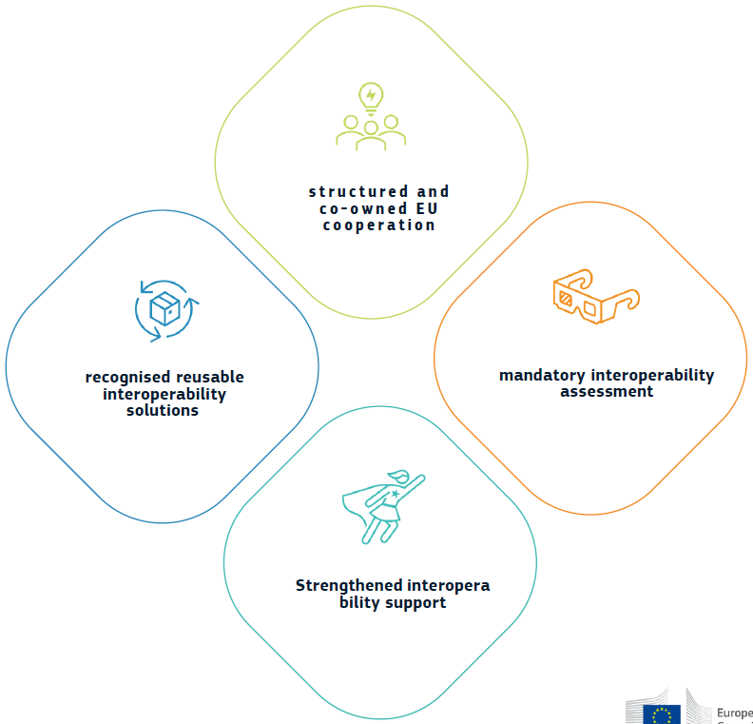
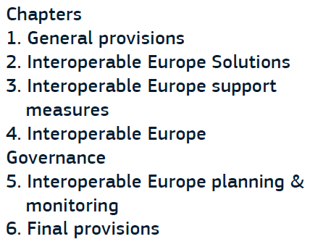
Key pillars

Slide 29
Interoperability assessment
Art 3: verplichte assessment
- voor bindende beslissingen die invloed hebben op interoperabiliteit van cross-border systemen
- gebaseerd op EIF
- rapport verplicht in machine-readable format op officiële website en verplicht in te dienen bij Board
- zaken die al afgedekt zijn door EU impact assessment moeten niet opnieuw geassessed worden op nationaal niveau
- Board voorziet ondersteunende guidelines/hulpmiddelen voor uitvoering van assessments

Slide 30
Interoperability support
Art 9: support projects
Art10: innovation measures
Art 11+12: interoperability regulatory sandboxes (min 3 participants)
Art 13: training: board provides free training material & online training programmes, EU&MS provide training programmes for staff
Art 14: peer reviews (voluntary, by experts from other MS)

Slide 31
National Competent Authority & SPOC (Art 17)
Meerdere NCA’s mogelijk, maar 1 enkele SPOC NCA per MS
Taken SPOC:
coördinatie NCA’s + afstemming met EU & andere lidstaten
Taken NCA’s:
- ondersteuning interoperability assessments
- coördinatie & promotie deelname aan support measures
- stimulatie reuse via portal(s)
administraties ondersteunen bij samenwerking met administraties van andere lidstaten
Awareness & training activiteiten op vlak van interoperabiliteit
MS moeten voldoende competente ressources voorzien.

Slide 32
Timing (tov entry into force: 11/04/2024)
3M (11/07/2025): IEA becomes applicable
9M (11/01/2025):
Verplichte impact assessments + guidelines (COMM)
NCA’s aanduiden + SPOC communiceren aan COMM
Verplichte share & reuse (art 4) + guidelines
12M (11/04/2025): implementing acts regulatory sandboxes
45M : 4-jaarlijks rapport door Commissie

Slide 33
Aanpak op nationaal niveau?
NCA’s: momenteel: BOSA (SPOC) + Vlaanderen + Brussel(?)
=> streven naar 1 NCA per regio, of misschien zelfs naar 1 NCA per dienstenintegrator?
Coördinatie: via ICEG?
=> zo ja, zorgen dat de juiste mensen aan de ICEG deelnemen!
=> daarnaast afstemming via mail ter voorbereiding van EU Interoperable board meetings?
Belgif portaal: heeft grondige update nodig (vb met uitleg over IEA, NCA’s, interoperability assessments, …)
=> welke info willen de NCA’s/regio’s erin opnemen (vb eventuele doorverwijzing naar regionale portalen?)
=> opm: wat doen we met reusable solutions in BE ? Ook op Belgif? Of op portaal van ICT- Reuse? EU Comm vraagt immers integratie/synchronisatie met Interoperable Europe Portal
Publicatie impact assessments: op website instelling of centraliseren (vb op Belgif portaal)?
Inplannen van communicatie campagne om awareness op vlak van IEA te verhogen?

Slide 34
QUESTIONS?
nicolas.vervaeck@bosa.fgov.be

